Slide 1
Financial Analysis Project in Excel (Documentation)

Slide 2
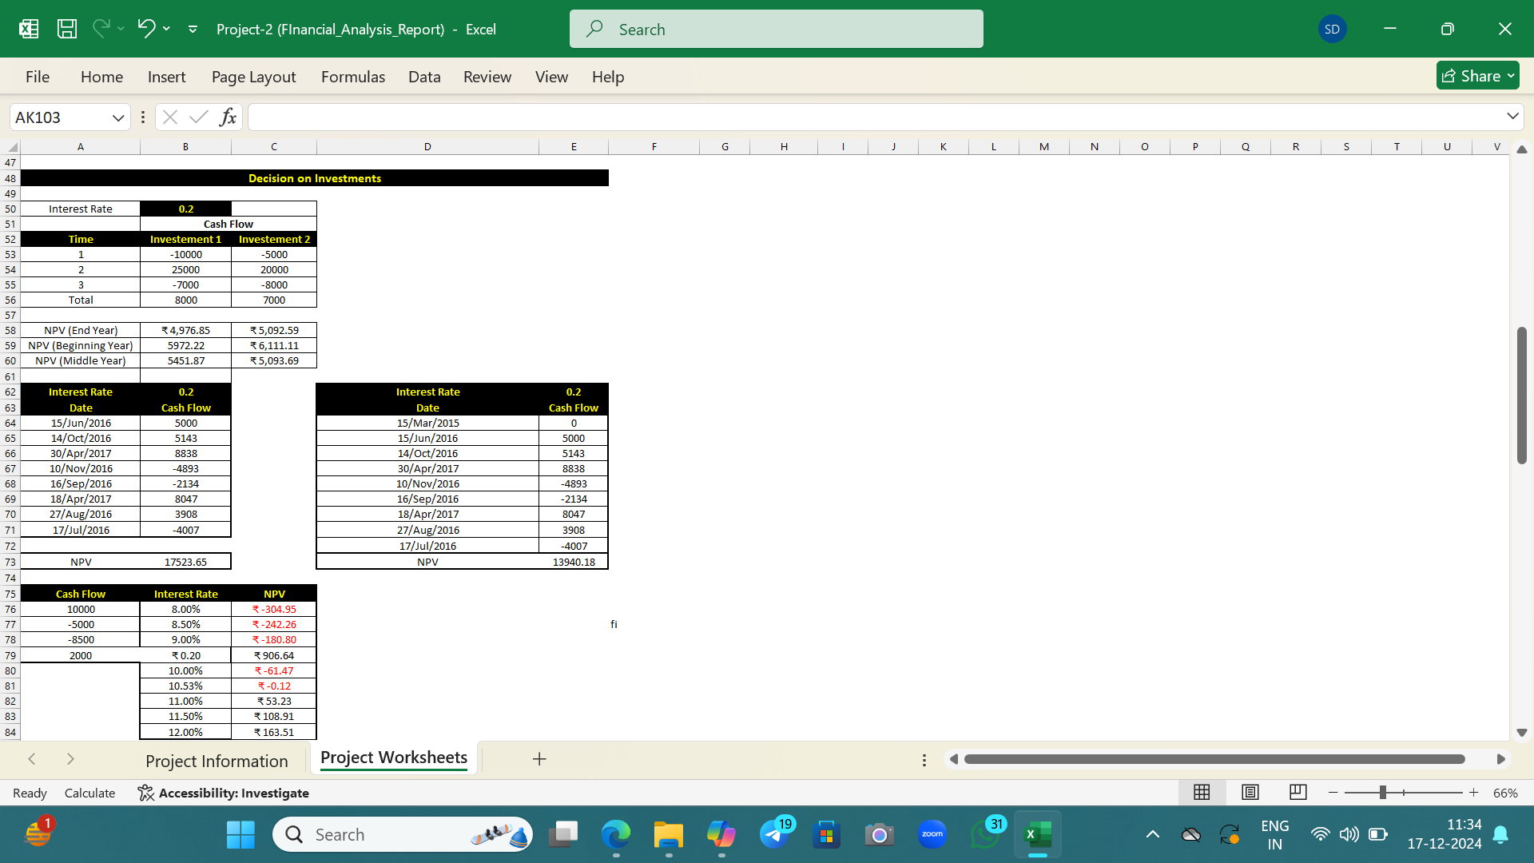

Slide 3
1.Annuity Calculations
Payment Value: Calculating the present value of annuities based on payments at the beginning and end of the year.
Interest Rate Impact: Understanding how the interest rate affects the present value of the annuity payments.
2.EMI Calculations:
Loan Amount and EMI: Calculating the equated monthly installments (EMIs) for different loan amounts and interest rates.
Interest and Principal Split: Breaking down the EMI into interest and principal components over the loan term.
3.Interest and Principal Calculations:
Specific Month Analysis: Identifying the amount of interest paid and the principal repaid between specific months.
4.Amortization Schedule:
Monthly Breakdown: Detailed month-wise breakdown of EMI payments, showing the beginning balance, interest, principal, and ending balance for each month.

Slide 4
5.Term Loan Calculations:
Overall Loan Impact: Assessing the impact of the loan term and interest rate on the total repayments
6.Term Loan Calculations:
Overall Loan Impact: Assessing the impact of the loan term and interest rate on the total repayments.

Slide 5
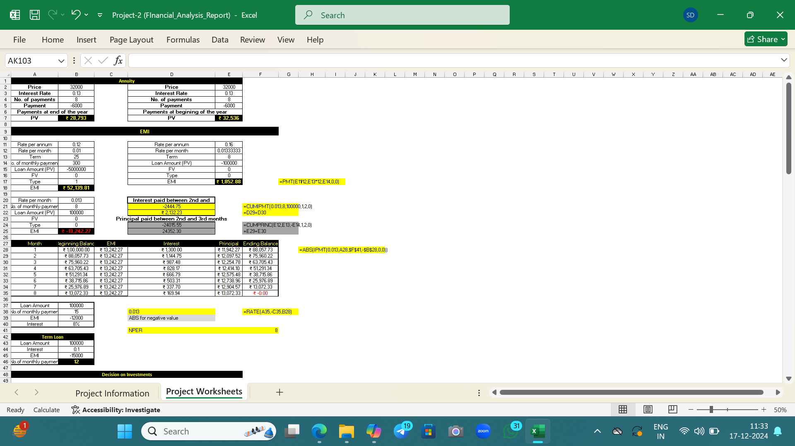

Slide 6
Decision on Investments
Key Findings
Investment 1:
NPV at End Year: ₹4,976.85
NPV at Beginning Year: ₹5,972.22
NPV at Middle Year: ₹5,451.87
Investment 2:
NPV at End Year: ₹5,092.59
NPV at Beginning Year: ₹6,111.11
NPV at Middle Year: ₹5,093.69
Overall NPV:
Cash flows were analyzed for different periods, and NPVs were computed for each period.

Slide 7
Actionable Insights
Investment Decisions:
Investment 2 shows a slightly higher NPV compared to Investment 1, suggesting it may provide better returns.
Consider investing more in Investment 2 for potentially higher profitability.
Interest Rate Impacts:
High interest rates have a significant impact on the present value of cash flows.
When making investment decisions, account for the effects of varying interest rates.
Analysis
Methodologies:
NPV calculations were conducted using different time periods: end year, beginning year, and middle year.
Cash flows from different investments were analyzed to determine their impact on overall value.

Slide 8
Approaches:
Detailed breakdowns of cash inflows and outflows for each investment period.
Comparing NPVs of various investments to assess potential returns.
Conclusions
Investment 2 is more favorable based on its slightly higher NPV in all time periods analyzed.
Interest rate considerations are crucial in investment planning and decision-making.
Analyzing cash flows and NPVs provides valuable insights for making informed investment choices.

Slide 9
IRR
IRR Insights:
Investment 1 shows an IRR of 17.32%.
Investment 2 has a higher IRR at 27.62%, suggesting better returns.
Consider the varying IRR results when making investment decisions.
Actionable Insights
1.Investment Preference:
Allocate more resources to Investment 2 for potentially higher profitability due to its higher IRR.
2.Interest Rate Impact:
Take into account the significant effect of high interest rates on the present value of cash flows when planning investments.

Slide 10
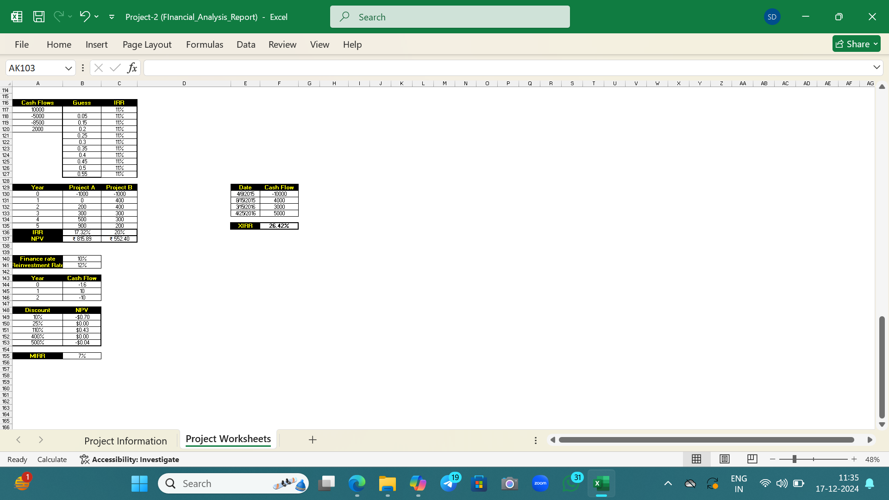

Slide 11
Methodology
NPV and IRR Calculations:
Calculated using different time periods: end year, beginning year, and middle year.
Detailed breakdowns of cash inflows and outflows for each investment period.
Comparison Approaches:
Comparing NPVs and IRRs of various investments to assess potential returns.
Extended Analysis:
Using XIRR for specific dates to evaluate cash flow over time.

Slide 12
Conclusion
Investment 2:
More favorable based on higher IRR and NPV.
Interest Rate Considerations:
Must be carefully factored into financial planning to optimize investment decisions.

